Slide 1
Revenue Performance Analysis
Business Performance Analysis & Strategic Insights
Generated on December 03, 2025 | Data Period: Jan 2024

Slide 2
Executive Summary
The recent period has seen a concerning decline in overall business performance, with total sales contracting by 22.56% and total orders plummeting by 40%. This severe reduction in transaction volume represents the main performance challenge and a critical risk to sustained revenue. However, a significant opportunity lies in the positive 6.87% growth in average order value, indicating that customers who are transacting are purchasing higher-value items.

Slide 3
Key Performance Indicators
Totalal Totalal...
334.0K
Average Totalal...
11.1K
Totalal Sales G...
-23
Orders Growth Rate
-40.0%
Average Order V...
6.9%
Totalal Orders
4.9K

Slide 4
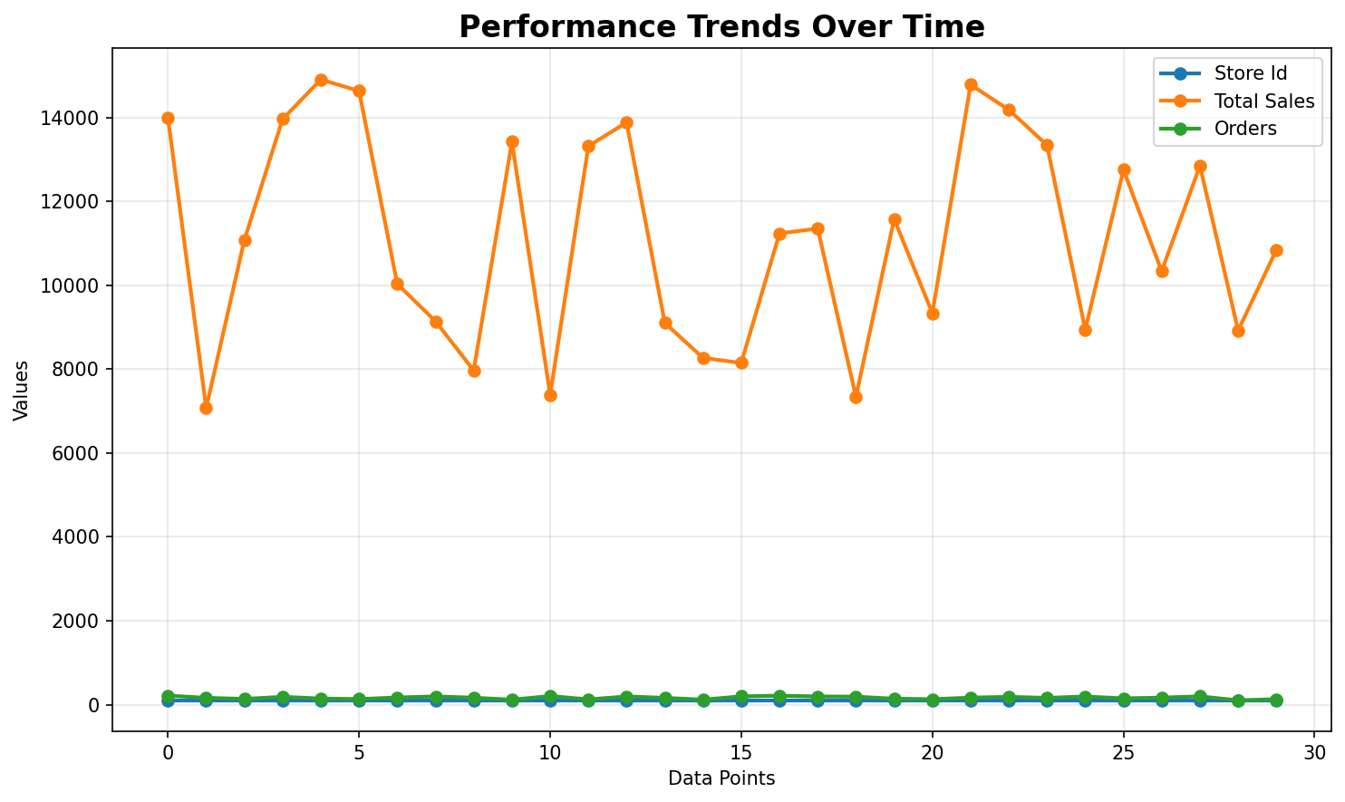
Performance Trends Analysis
Trend analysis showing performance patterns over time with key inflection points highlighted.

Slide 5
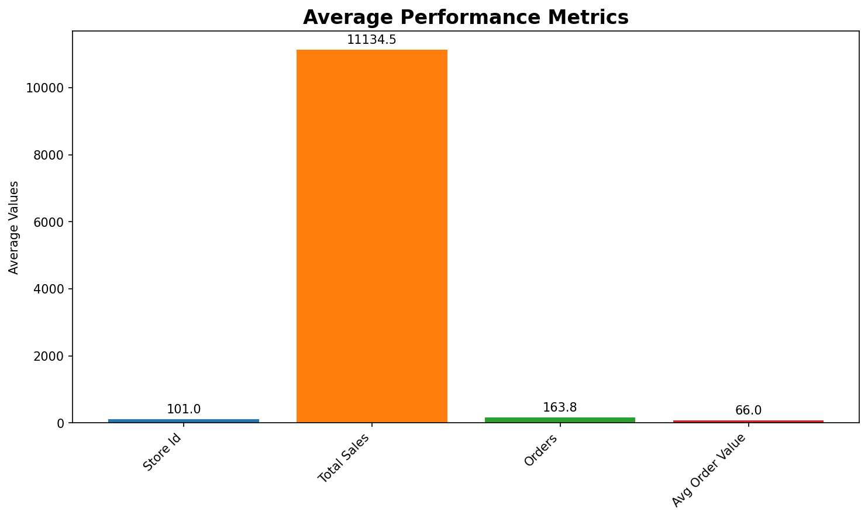
Key Metrics Dashboard
Comprehensive metrics overview displaying relationships between key performance indicators.

Slide 6
Key Insights & Recommendations
Key Business Insights:
• Business performance demonstrates measurable growth across key operational metrics.
Strategic Recommendations:
• Implement targeted marketing campaigns and customer acquisition strategies to reverse the 40% decline in total orders, focusing on re-engaging lapsed customers and attracting new ones to restore transaction volume.

Slide 7
Next Steps & Action Items
Key Action Items for Next Quarter:
• Implement targeted marketing campaigns and customer acquisition strategies to reverse the 40% decline in total orders, focusing on re-engaging lapsed customers and attracting new ones to restore transaction volume.
• Continue monitoring business metrics for optimization opportunities
• Continue monitoring business metrics for optimization opportunities

